Slide 1
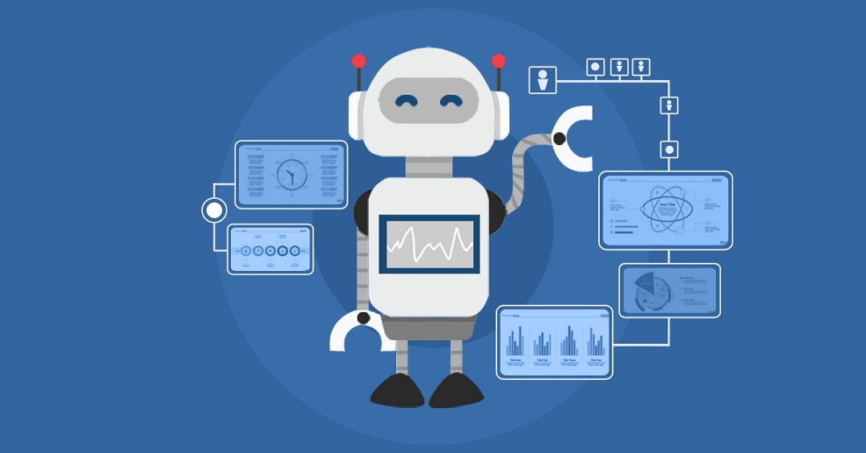
PERSONAL DESKTOP VOICE ASSISTANT
Presented by
Group ID: TBMP-20-21-GROUP-14
Under the Guidance of
Dr . S. H. Bhandari

Slide 2
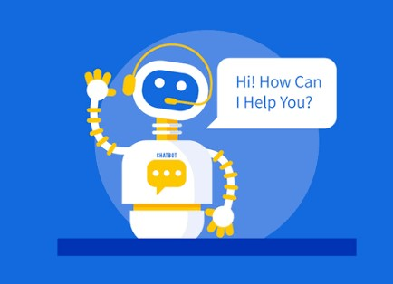
Problem Statement
Create a personal desktop voice assistant for windows OS, which can be used to interact with Laptops ,desktops and control their devices with voice commands.

Slide 3
Introduction
Importance of computers and assistant
Idea - creation of an inexpensive and easy to use assistant.
Examples: Siri/ Google Assistant.

Slide 4
Objectives
To Create an interface to provide voice instructions.
To implement speech recognition module to convert speech into text.
To implement Python Dictionary to find synonyms
To understand the context and give the user response accordingly.
To achieve efficiency of approximate 89 to 90 %.

Slide 5
Features
Get current date & time.
Interact with Google Search , Wikipedia & YouTube (Play videos or songs).
Shutdown, logout and Restart PC.
Open photos, videos, documents & downloads.
Take Screenshot.
Get CPU usage, Ram usage & Battery usage.
Jokes.
Search online and get related information which user is searching for.
Interacting with OS using voice commands.
Perform Mathematical Calculation using voice command.
Get local and Global news.
Get weather information.

Slide 6
Modules
Main Module
Features Module
News Module
Weather Module

Slide 7
Methodology
User
Input
Voice
Speech Recognise
Text
String
Extract Keywords
User
Output
Text to Voice
Query is Fired
Synonyms Vs Query
Extract Synonyms
Dictionary

Slide 8
Future Work
Add more Features.
Adding dictionary to all features.
Automating most of the work using this assistant

Slide 9
References
Python Documentation
https://pypi.org/project/SpeechRecognition/
https://pypi.org/project/PyDictionary/
https://pypi.org/project/PyAutoGUI/
https://pypi.org/project/pyttsx3/

Slide 10
Thank you

